Slide 1












BAYAN ALFORSAN
ARCHITECTURAL CONTRACTING
"From Concept to Concrete"
Commercial
Residential
Industrial
Company Profile 2025
info@alforsanco.com

Slide 2






About Us
Full-Service Contractor
Quality Workforce
Design, build & maintenance under one roof
Experienced, qualified professionals delivering top-tier contracting services
Market Presence
Full-Service Contracting
Operating since February 2016 with 9+ years of local expertise
One-stop solution: design-support, build, and maintenance
Company Profile 2025

Slide 3












Our Values
Integrity
Safety
Customer Satisfaction
Quality
Commitment
Excellence in every aspect of our work
Building with honesty and ethical practices
Prioritizing safety in all our operations
Dedicated to our clients and projects
Ensuring our clients are completely happy
"These values guide our decisions and define our character as a company."
Company Profile 2025

Slide 4










Our Commitment
We listen to your needs & budget, craft a detailed project plan, keep you informed at every stage, and stay available long after hand-over.
Listen
Plan
Communicate
Support
We attentively hear your needs and budget requirements
We create a detailed project plan with clear milestones
We keep you informed at every stage of the project
We remain available long after hand-over for any needs
Company Profile 2025

Slide 5






























Service Portfolio
Commercial Construction
Residential Construction
Industrial Construction
Maintenance & Renovations
Remodeling & Additions
Concrete Construction
Asphalt Works
Hangar Installation
Sound & Heat Insulation
Plumbing & HVAC
Electrical Maintenance
Gypsum-board Works
Tile Installation
Despacho (Finishing Carpentry)
Landscaping
Company Profile 2025

Slide 6





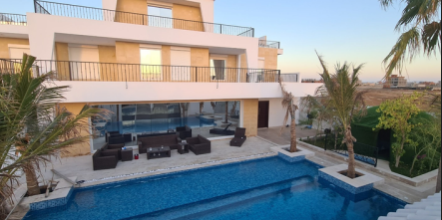
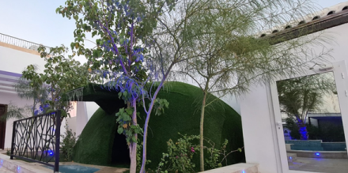




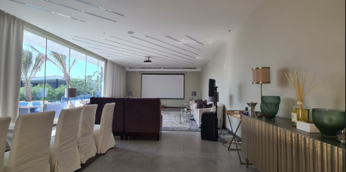
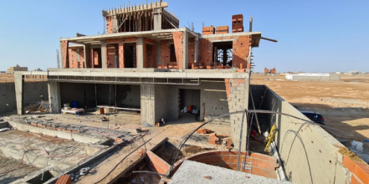
Residential Construction - Micro-Cases
Luxury Villa Tiling
Electrical System Upgrade
4,500 m²
Full-panel upgrade
High-end tiling installation for luxury residential property.
Comprehensive electrical system renovation with panel replacement.
Acoustic & Thermal Insulation
Pipe Replacement
Khobar
24-unit building
Complete acoustic and thermal insulation solution.
Complete plumbing system replacement in multi-unit building.
Company Profile 2025

Slide 7

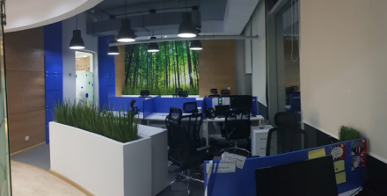
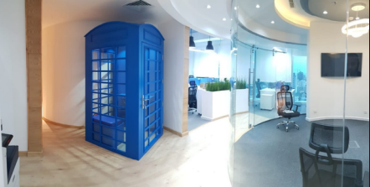





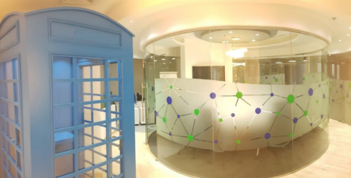
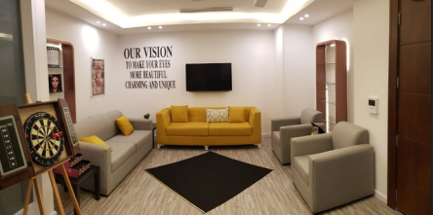




Commercial Construction - Micro-Cases
Office Renovation
On Time & Budget
HVAC Retrofit
20% Energy Savings
Office renovation project delivered according to specifications.
HVAC system upgrade with significant energy efficiency improvements.
Complete interior space renovation
Reduced energy consumption
Electrical Rewiring
SCECO Code
Fire-Alarm System
Design-Build
Electrical system rewiring to meet latest Saudi code standards.
Fire detection and suppression system design and installation.
Enhanced safety and compliance
Full safety compliance
Company Profile 2025

Slide 8

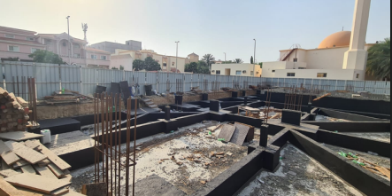
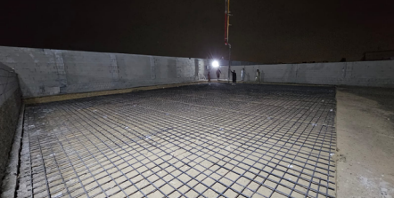




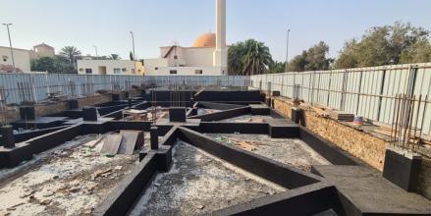
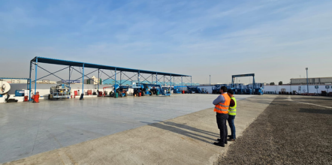




Industrial Construction - Micro-Cases
Super-Flat Epoxy Floor
Asphalt Overlay
Parking lot overlay with 15-year life extension
Level-10 epoxy floor application for warehouse
Process-Water Hangar
Landscape Upgrade
Specialized hangar system for 3rd Industrial City
Native planting for corporate HQ grounds
Company Profile 2025

Slide 9











Maintenance & Renovation Services
Comprehensive Maintenance
24/7 emergency call-out service with rapid response team
Advanced Equipment
24/7 Service Availability
State-of-the-art tools and OEM parts for all repair needs
Strategic Partnerships
Kababji restaurant chain - yearly maintenance partner
Round-the-clock
Year-round
Digital Project Management
Ready when you need us
Detailed digital snag list with photo sign-off capabilities
Company Profile 2025

Slide 10
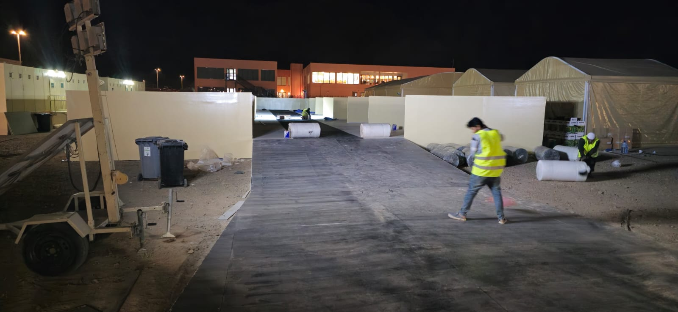


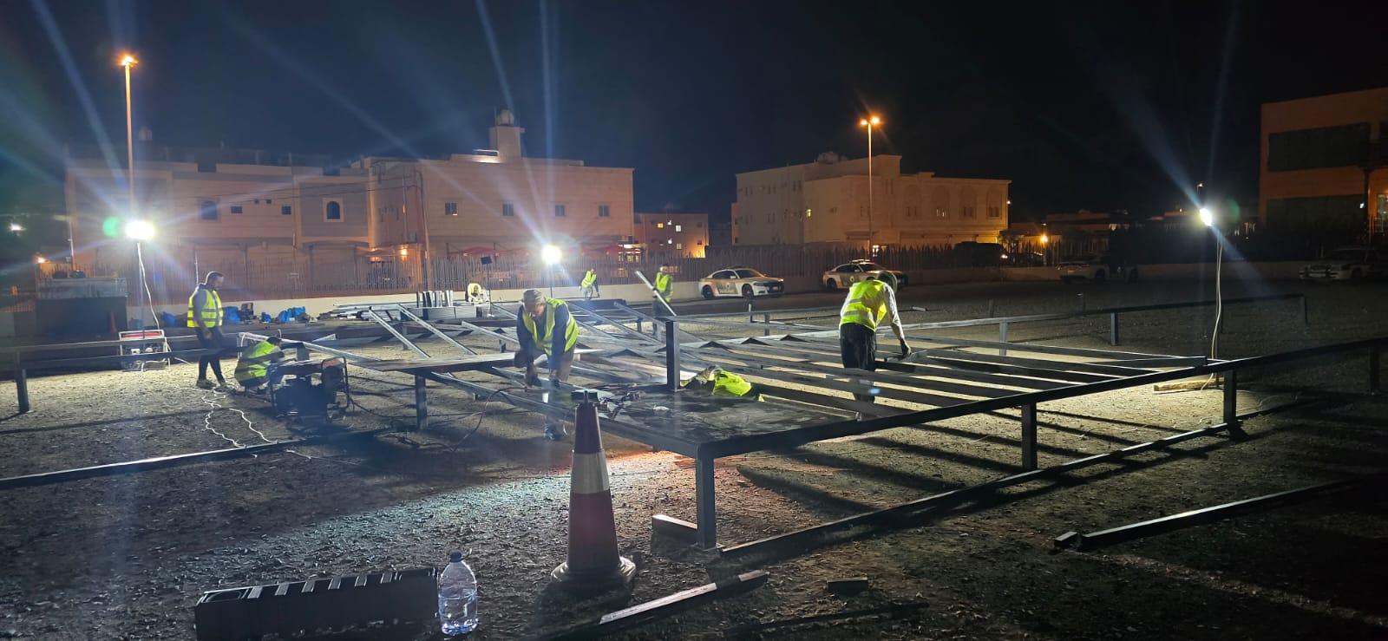

Major Project - AlUla Tour
Project Overview
Bayan Alforsan Architectural Contracting proudly delivered the AlUla Tour project, seamlessly translating design vision into built reality and reinforcing our reputation for precision, speed, and excellence in high-profile architectural contracting.
Services applied
Civil
Iron
Finishing
Company Profile 2025

Slide 11
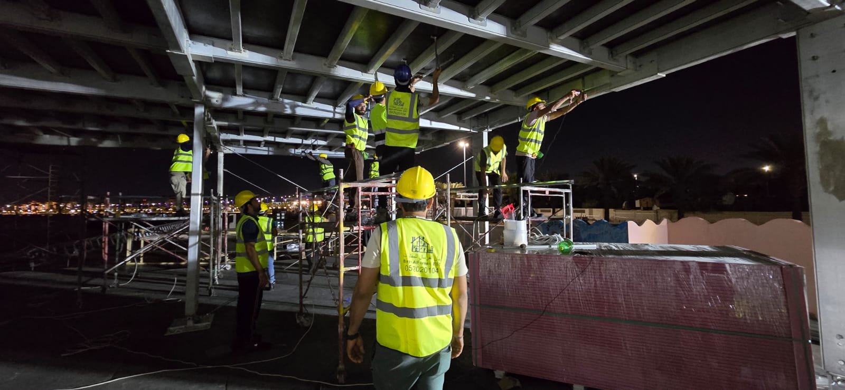
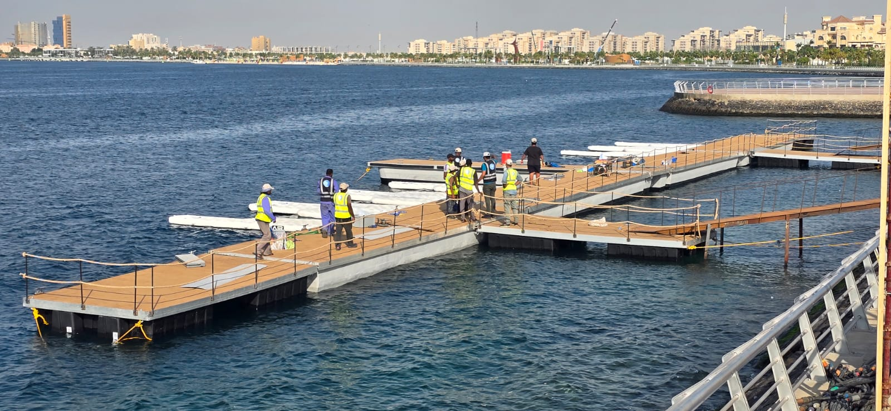
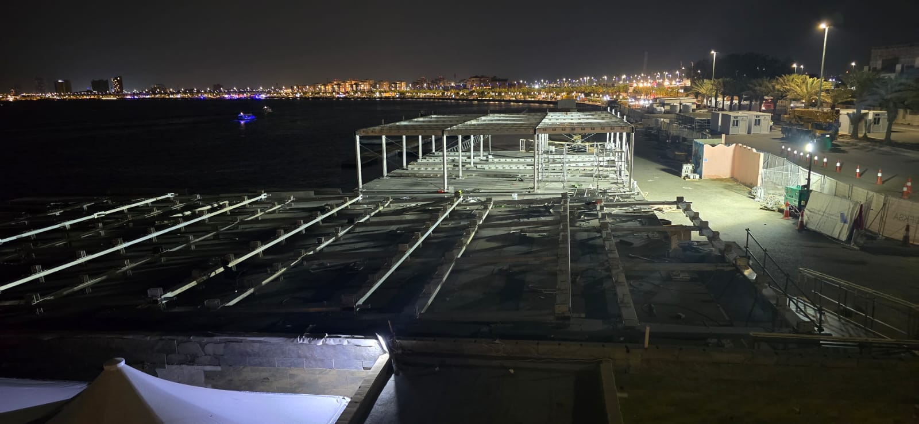
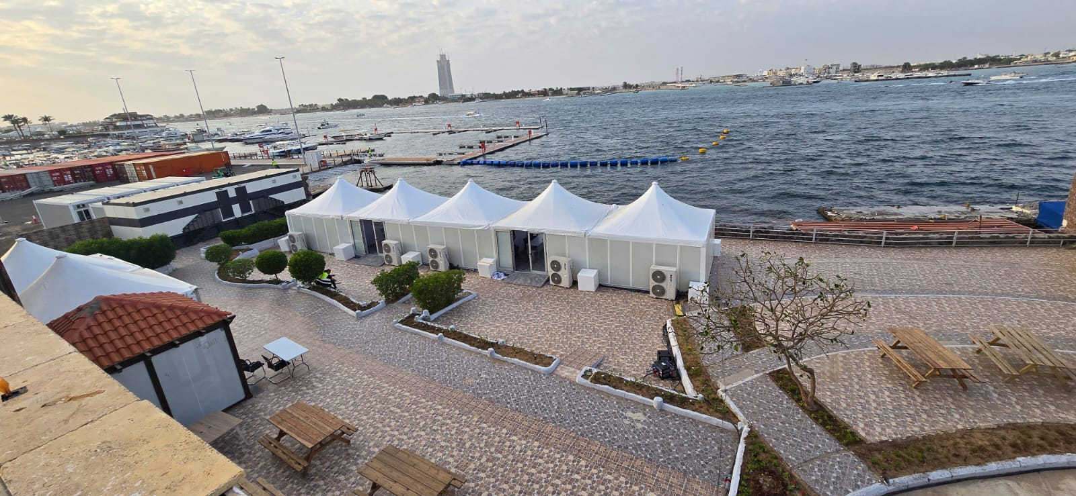
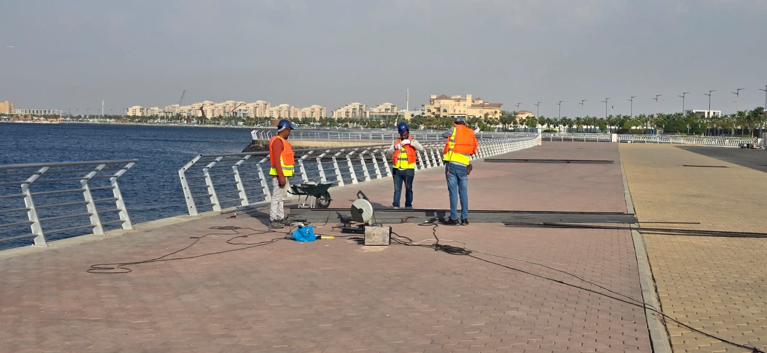
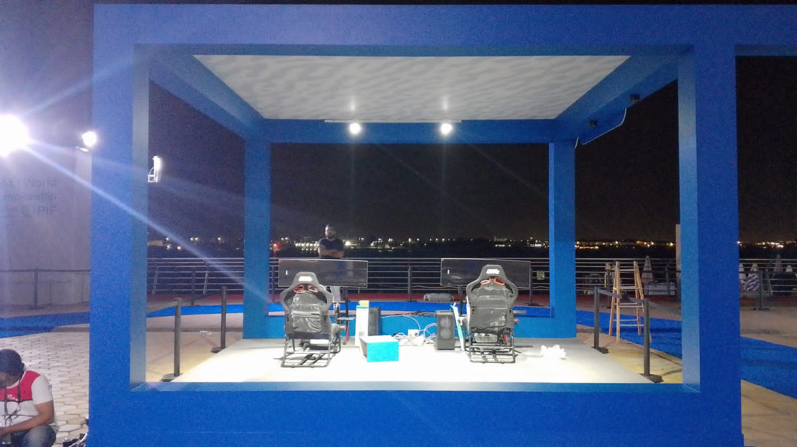
Major Project – E-ONE
Project Overview
Bayan Alforsan Architectural Contracting successfully delivered the E-ONE project—one of the largest undertakings in the company’s portfolio—showcasing its end-to-end design-build capability and proven capacity to execute complex, high-scale architectural works to the highest quality standards.
Services applied
Civil
Iron
Finishing
Company Profile 2025

Slide 12
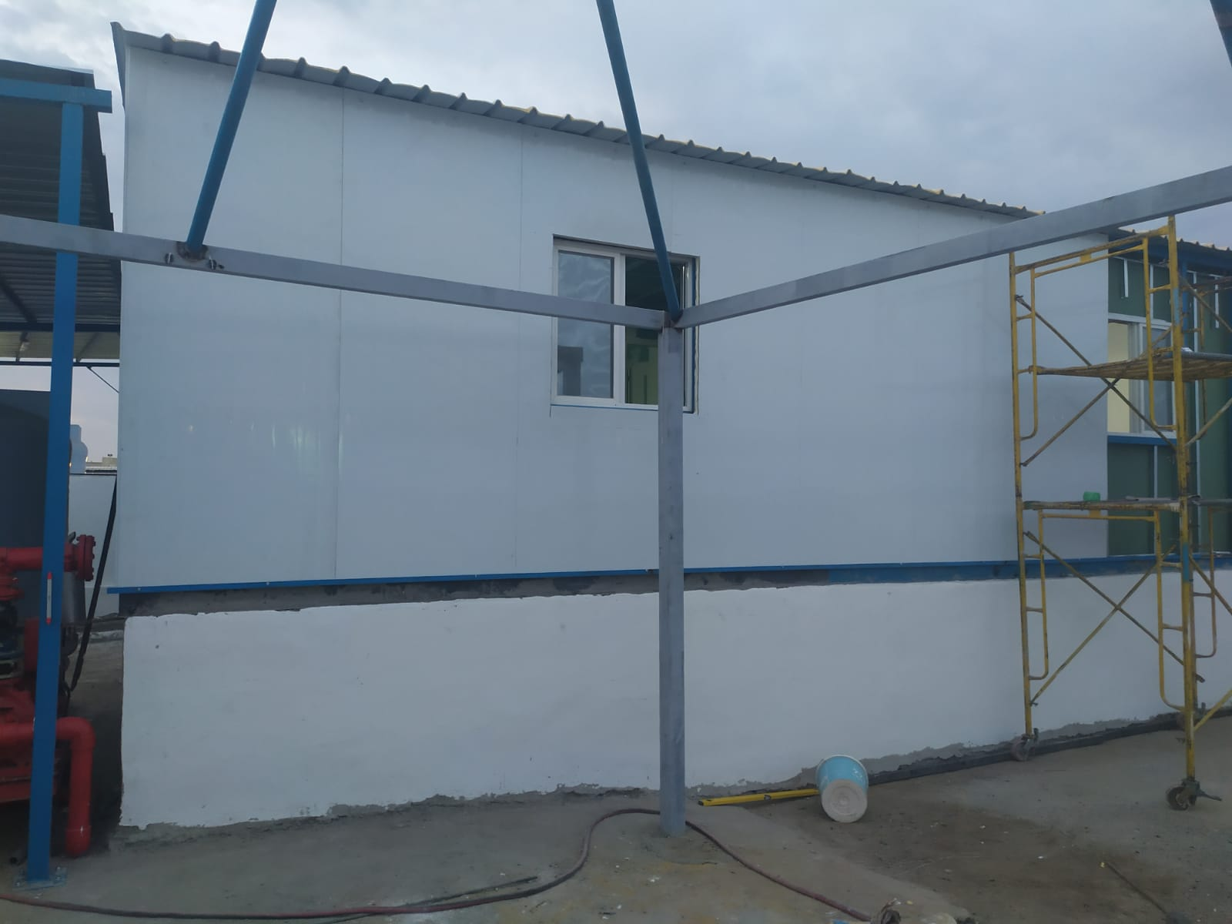
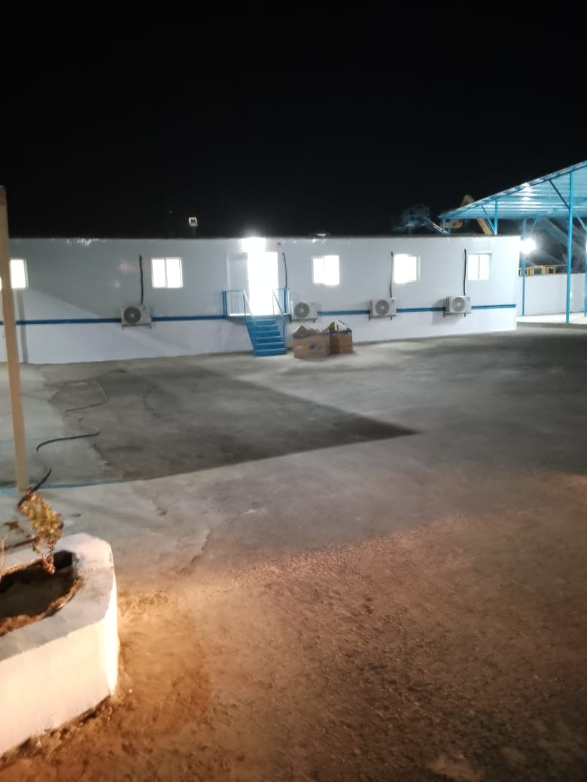
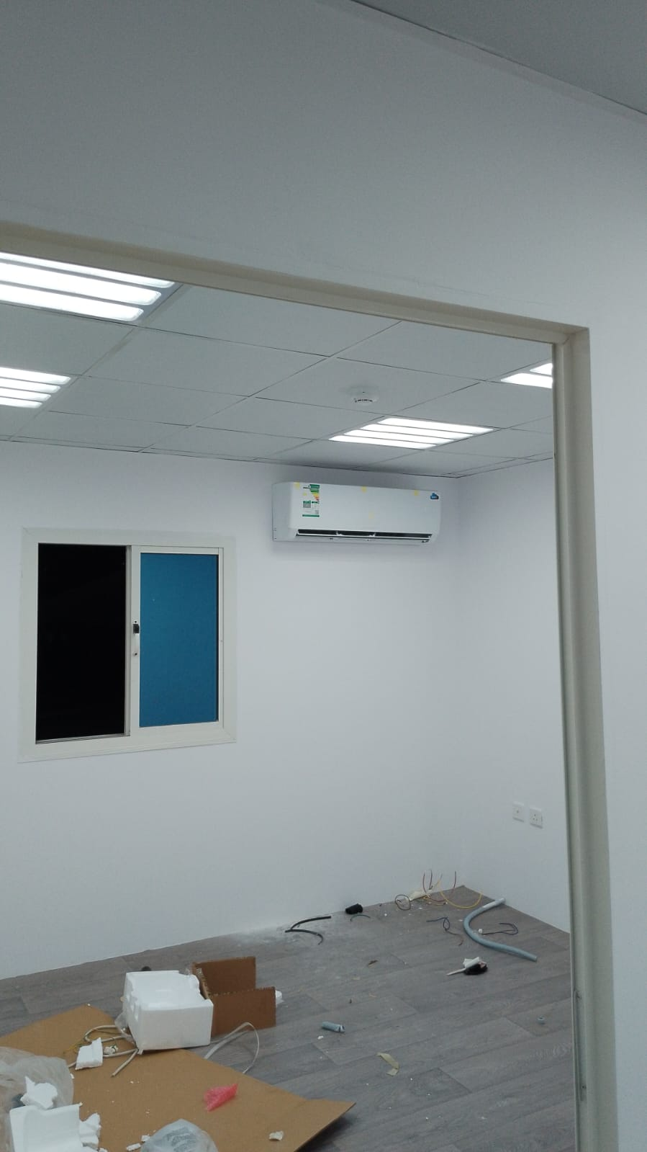
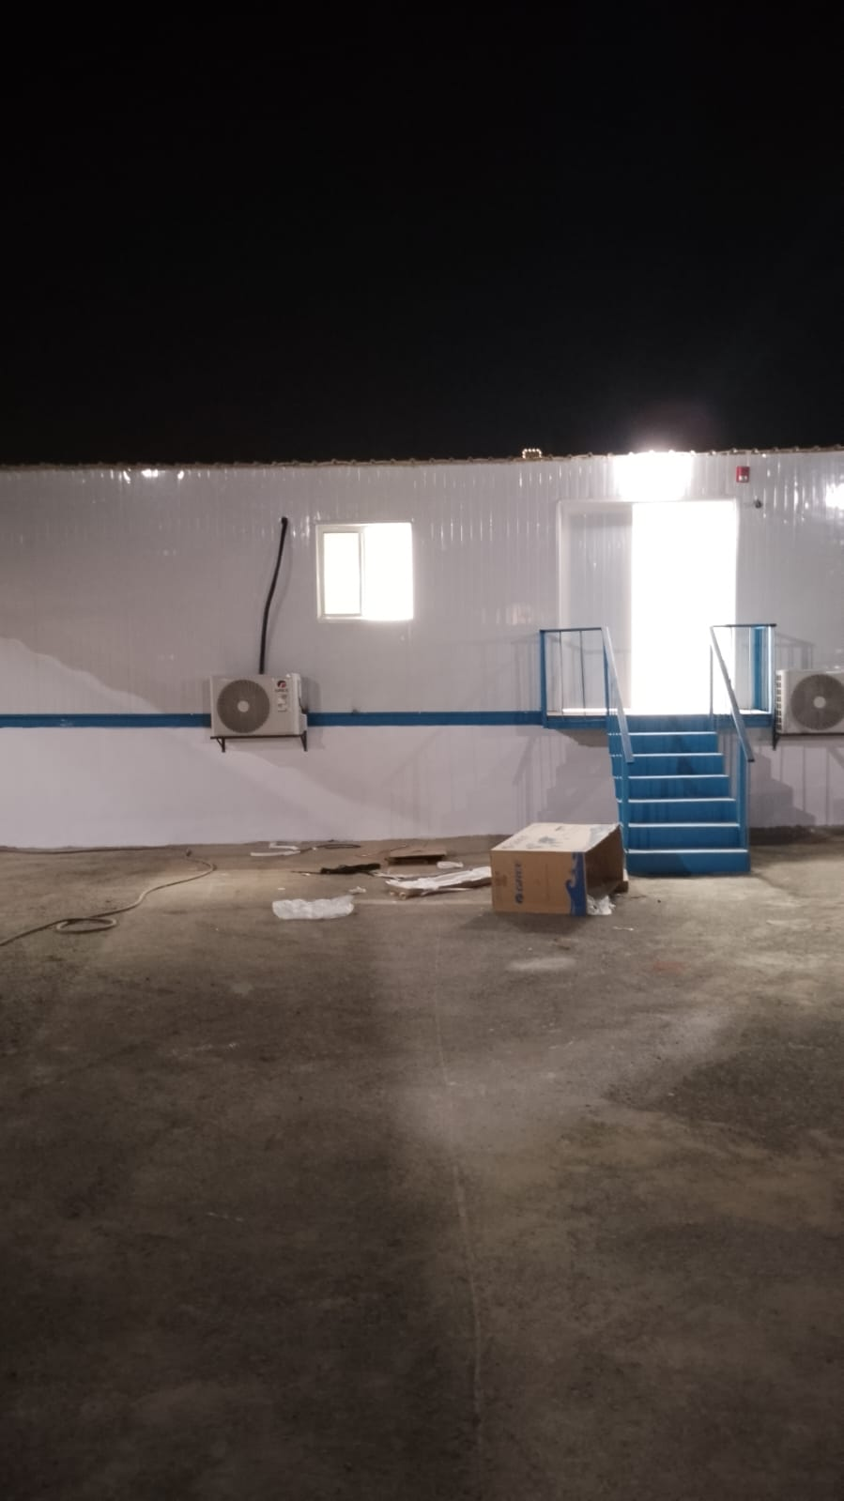
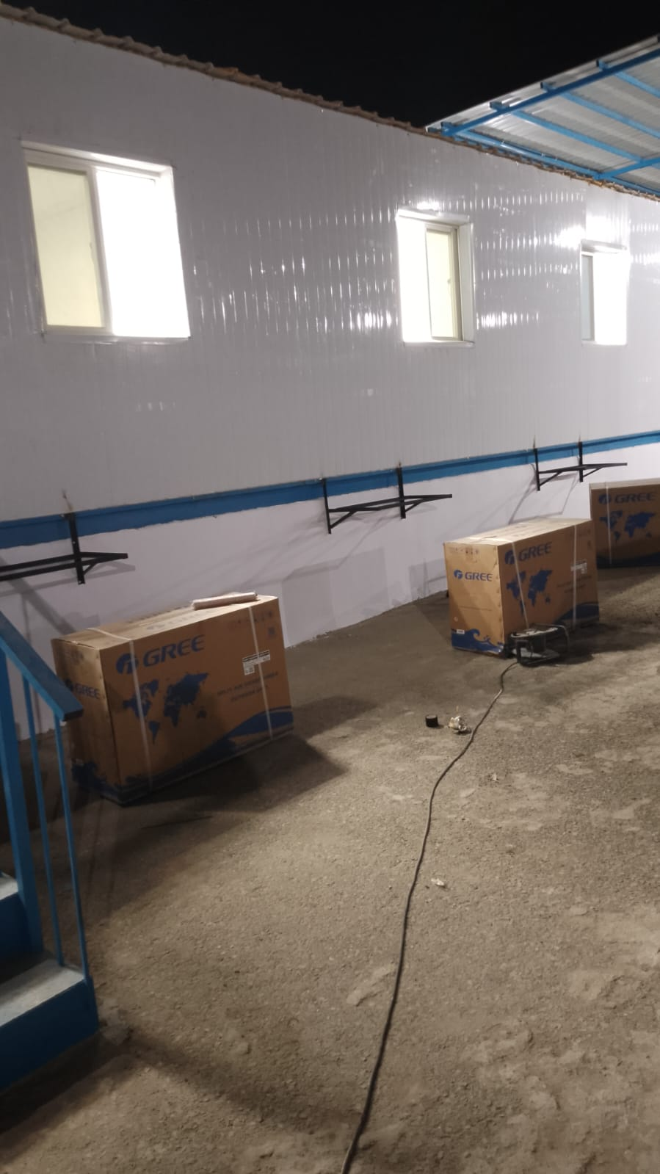
Major Project – SamaFlower
Project Overview
Bayan Alforsan delivered the complete design-build package for this high-profile development: site preparation, reinforced-concrete substructure and superstructure, insulated façade, roofing, and integrated MEP rough-in, all finished to drawing and handed over ahead of the contract programme.
Services applied
Civil
Iron
Finishing
Company Profile 2025

Slide 13
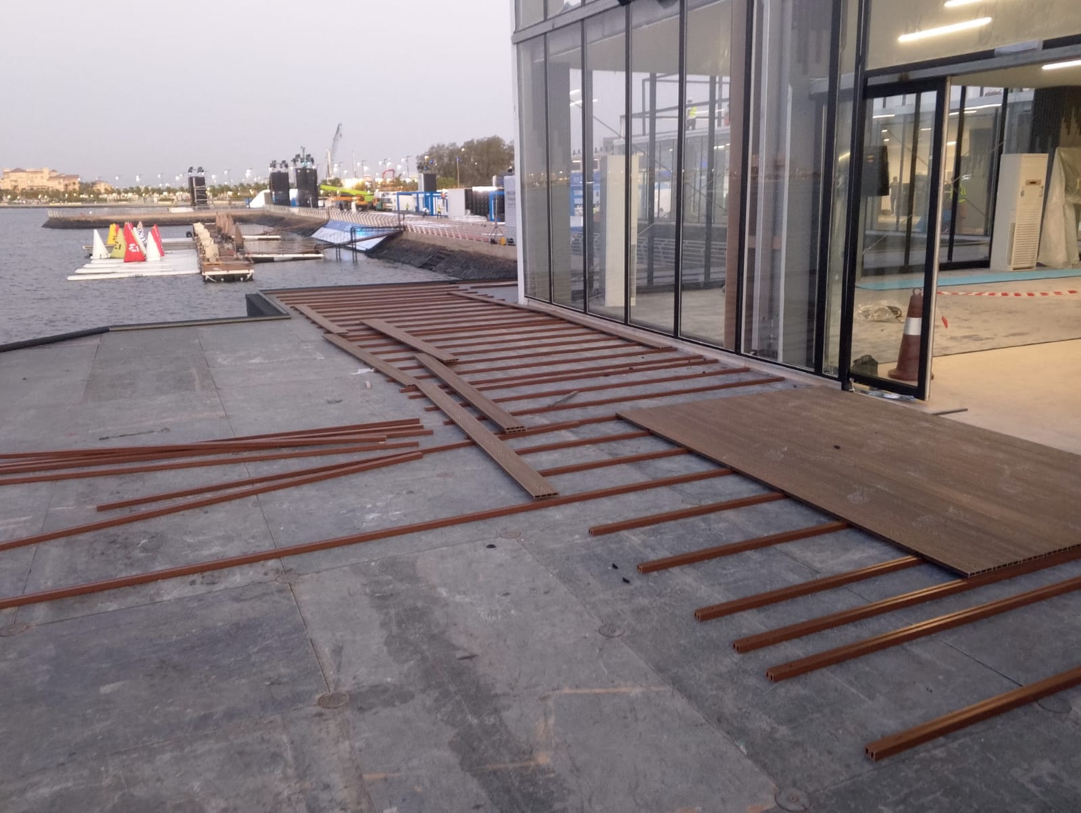
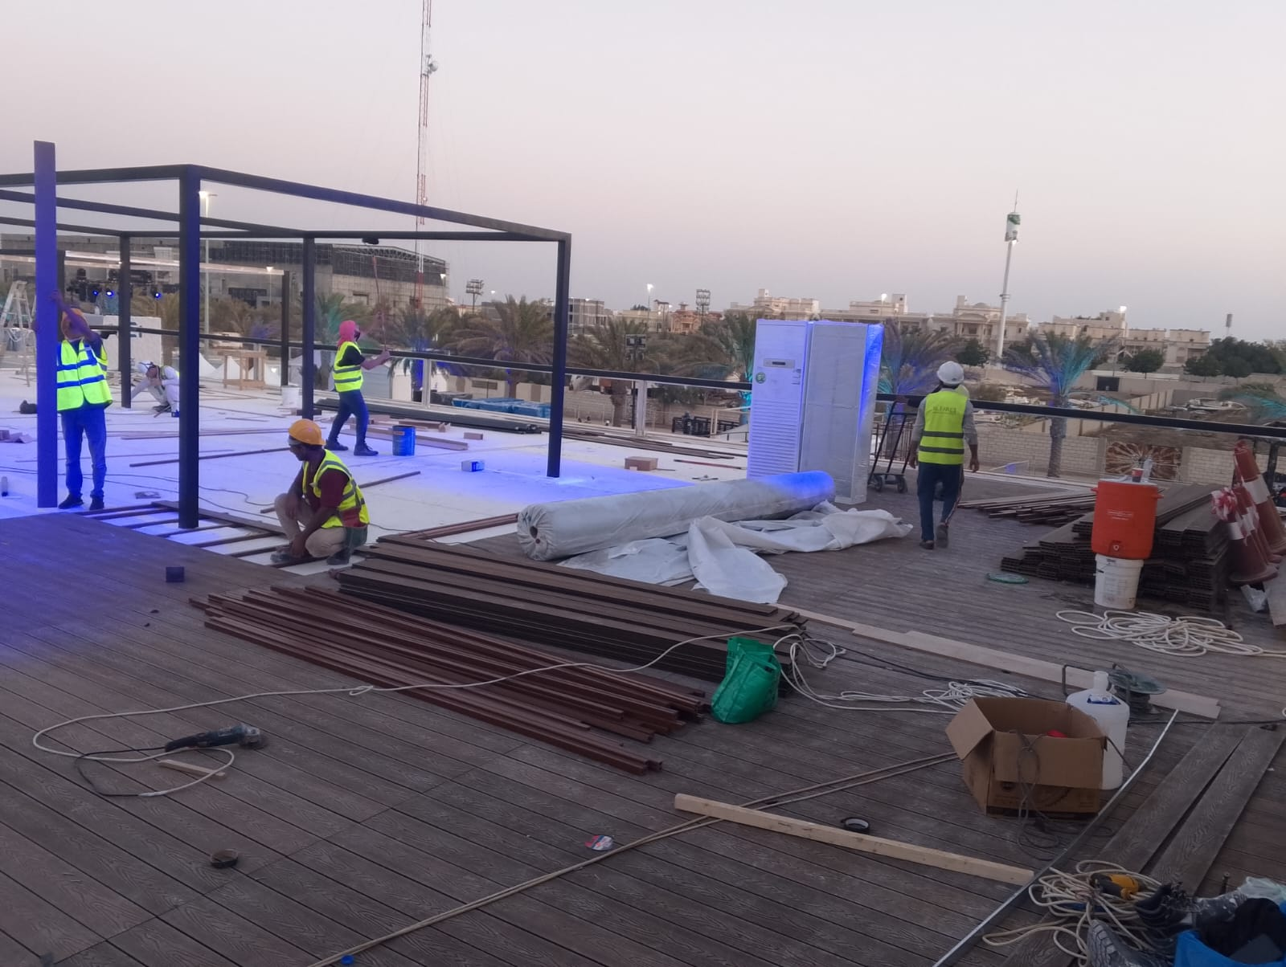

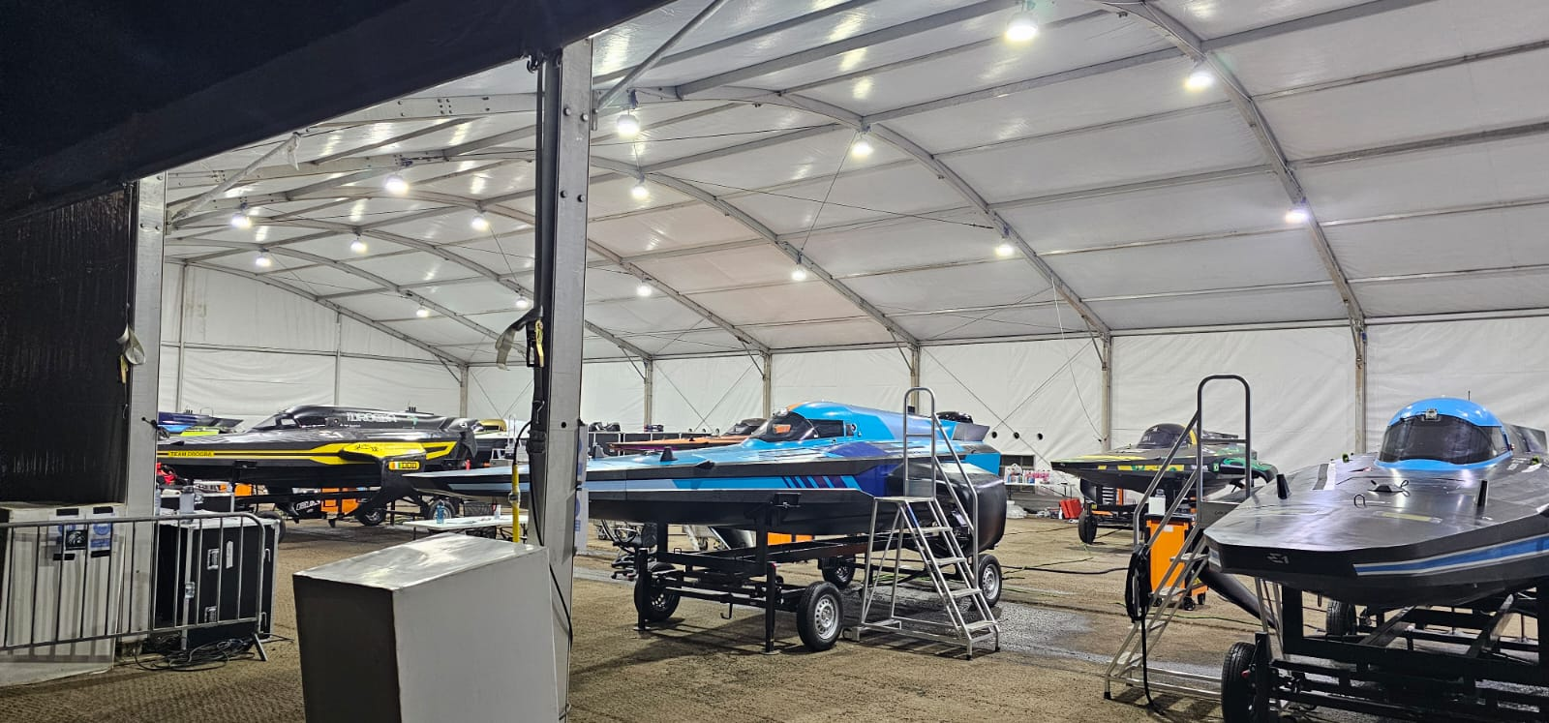
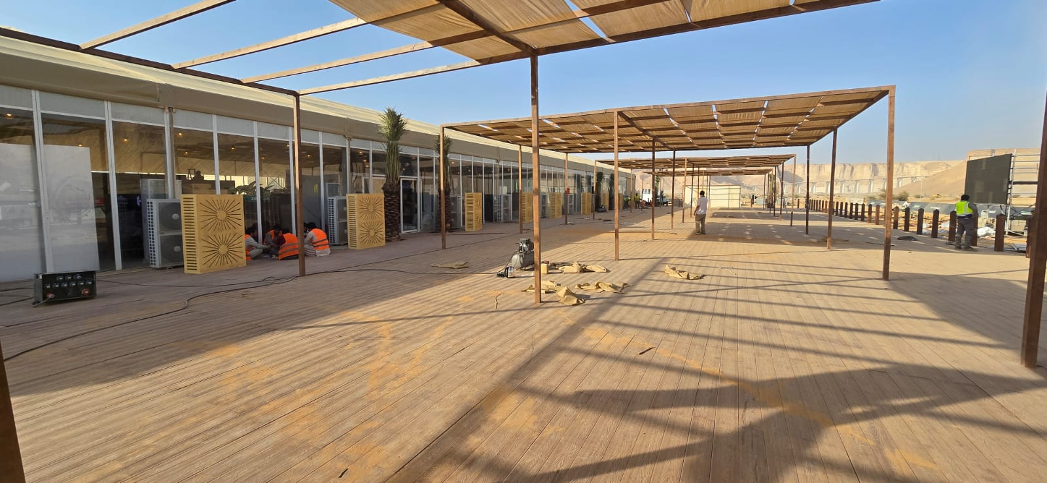
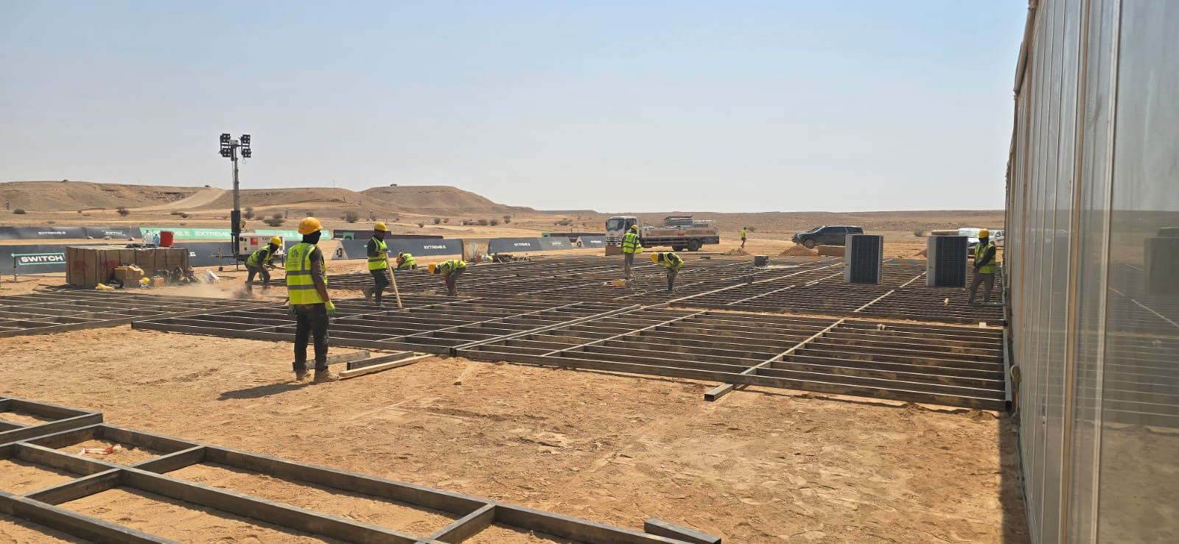
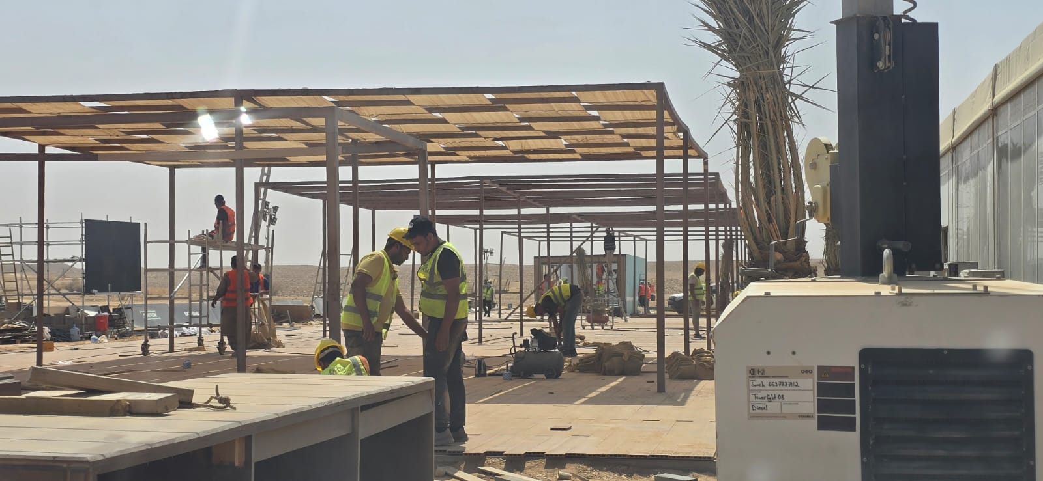
Major Project – Stream E
Project Overview
Stream E ranks among the largest projects Bayan Alforsan has delivered: the team coordinated every design-build discipline, met an accelerated schedule, and handed over a fully finished facility that met every specification without compromise
Services applied
Civil
Iron
Company Profile 2025

Slide 14
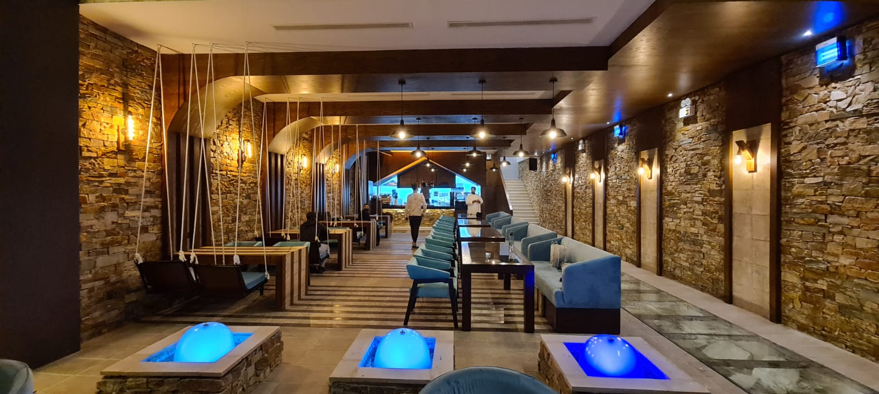
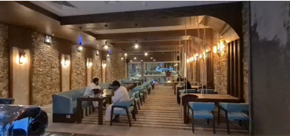
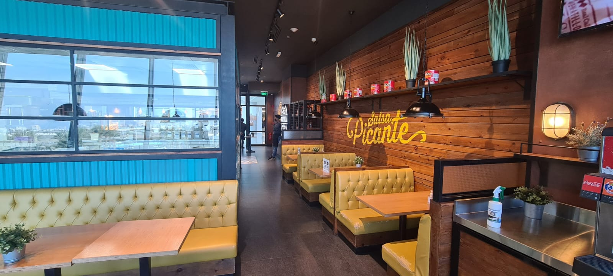
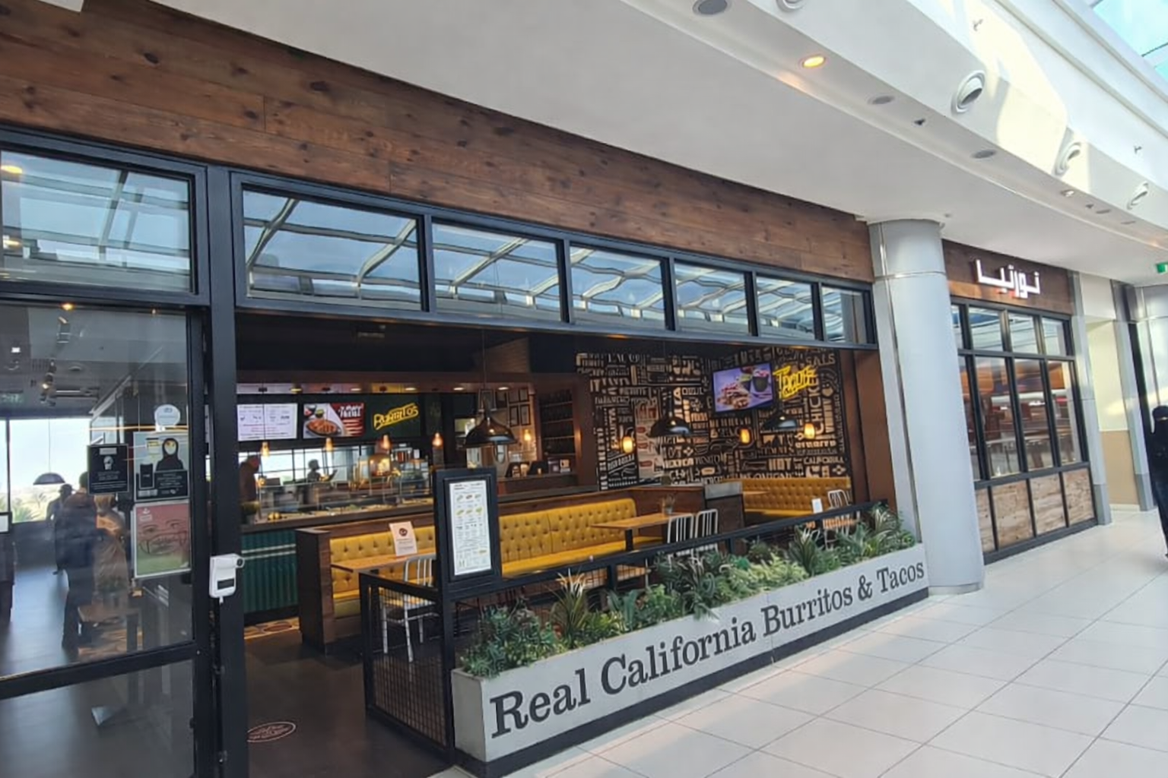
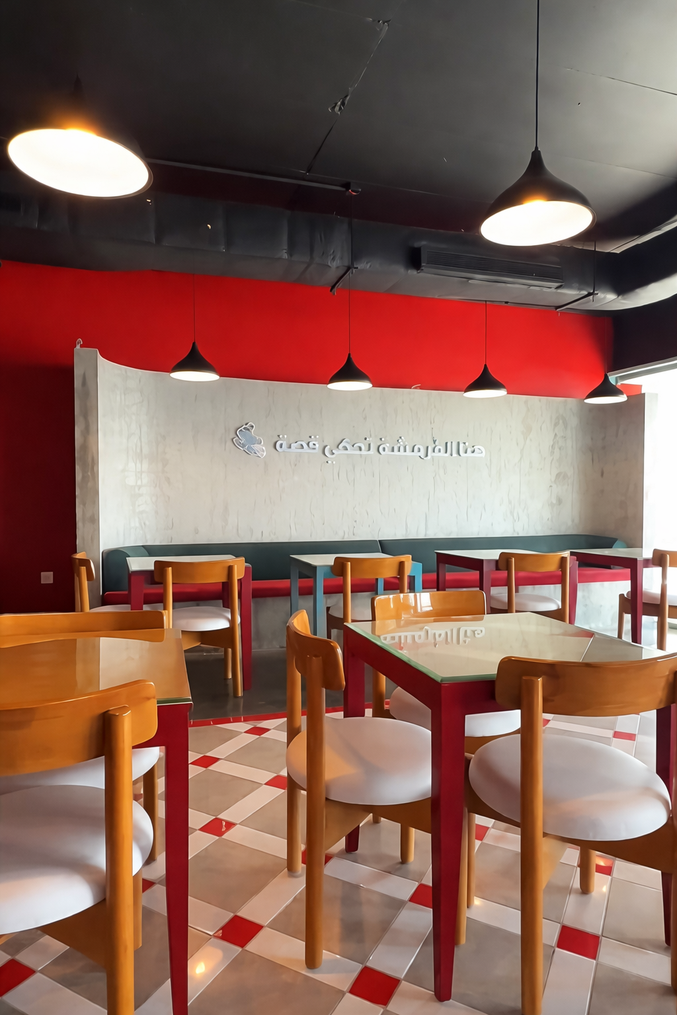
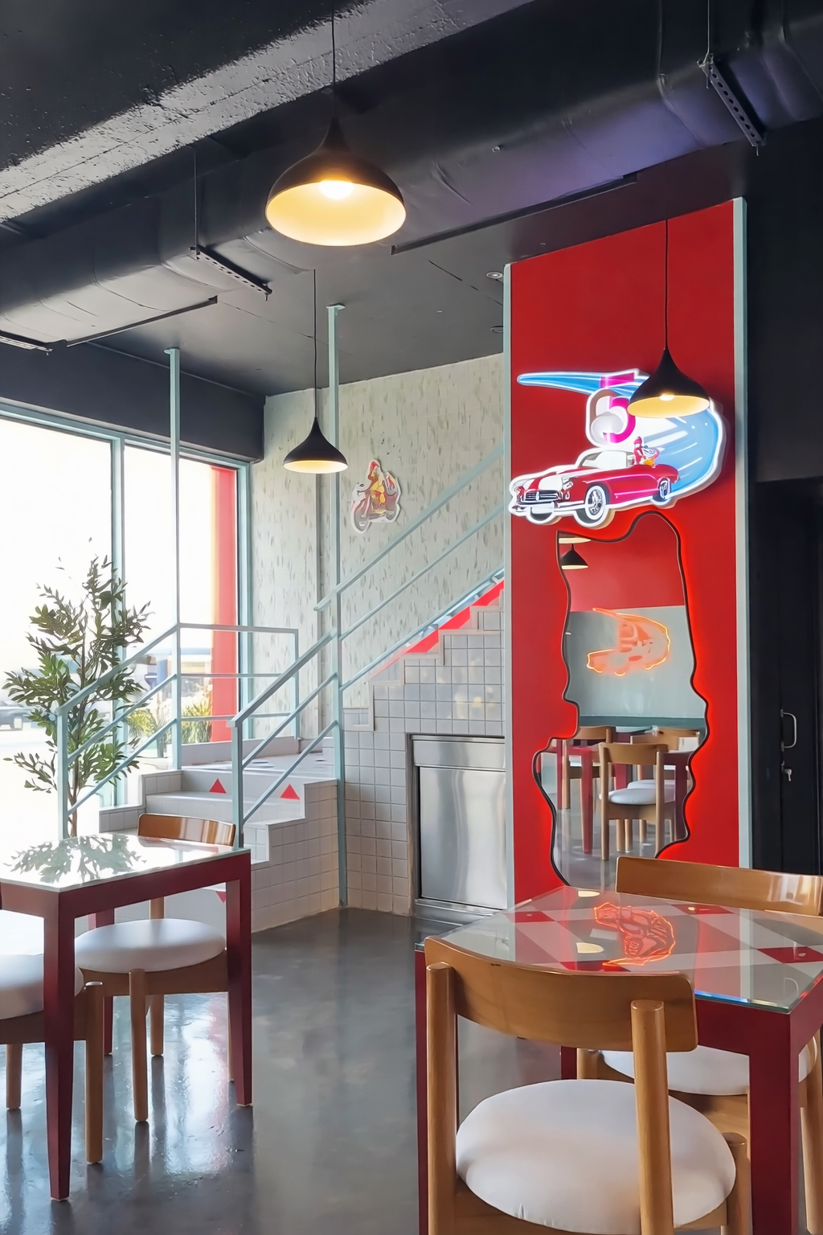
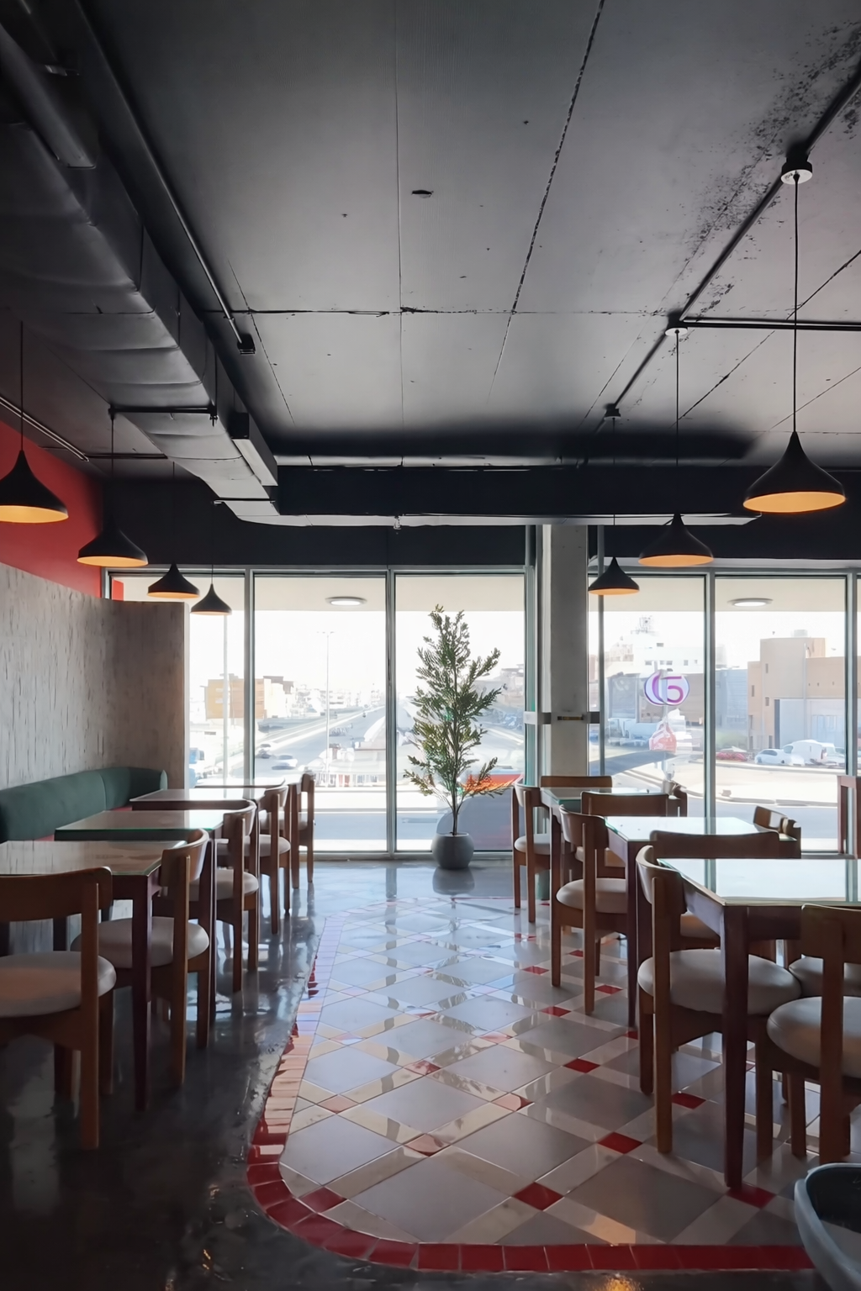
Restaurant Construction & Shellworks
Overview
Bayan Alforsan delivered full shell-and-core builds for multiple restaurants—foundations, blockwork, MEP rough-ins, and final finishes—turning empty slabs into operating outlets on time and to brand standards.
Company Profile 2025

Slide 15
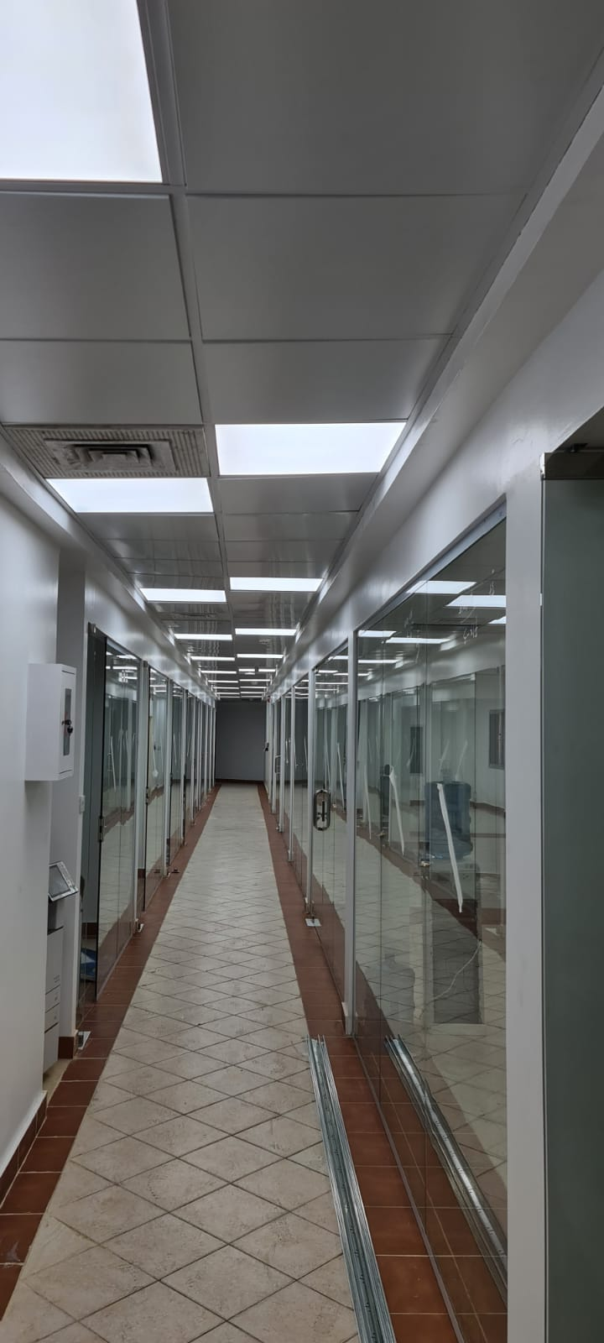
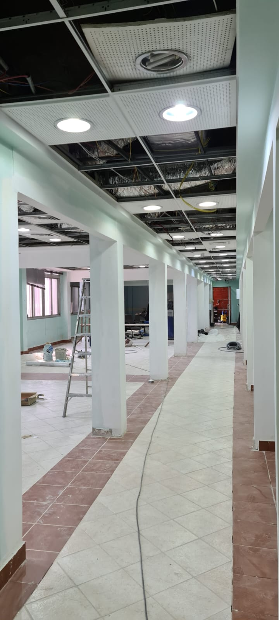
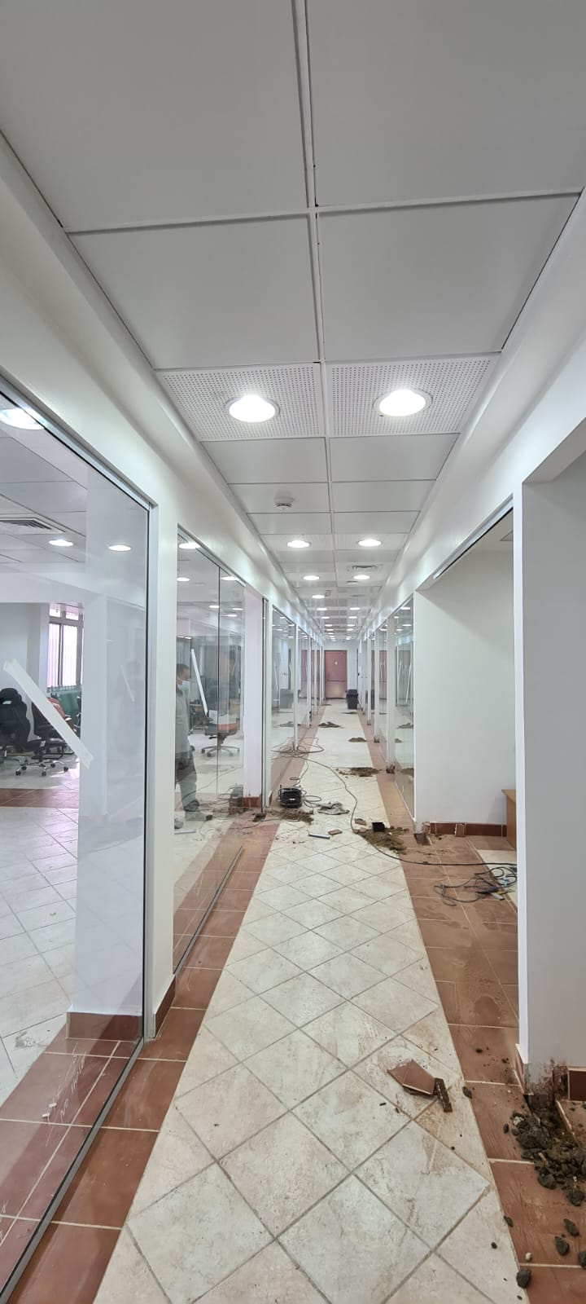
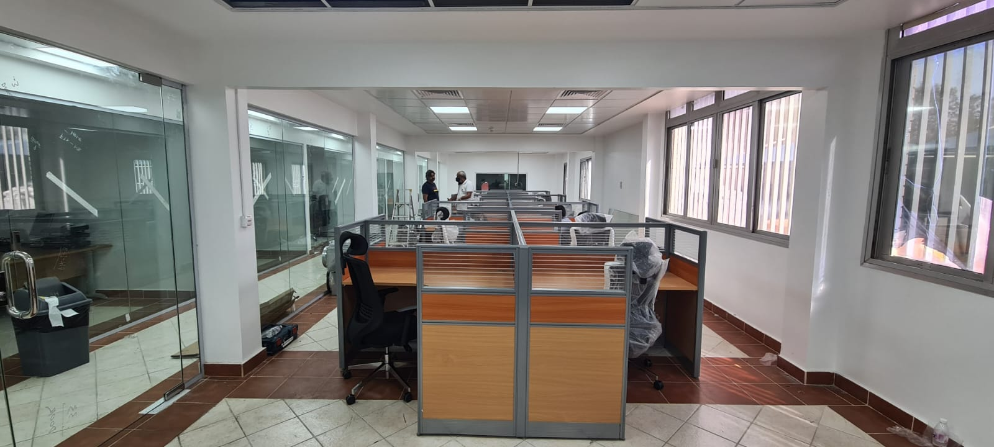
Office Installation
Overview
Bayan Alforsan transforms empty floorplates into fully functioning workplaces: erecting light-gauge partitions, installing raised flooring, suspended ceilings, power and data infrastructure, glazing, and final finishes—each suite delivered snag-free and ready for furniture on the date promised.
Company Profile 2025

Slide 16
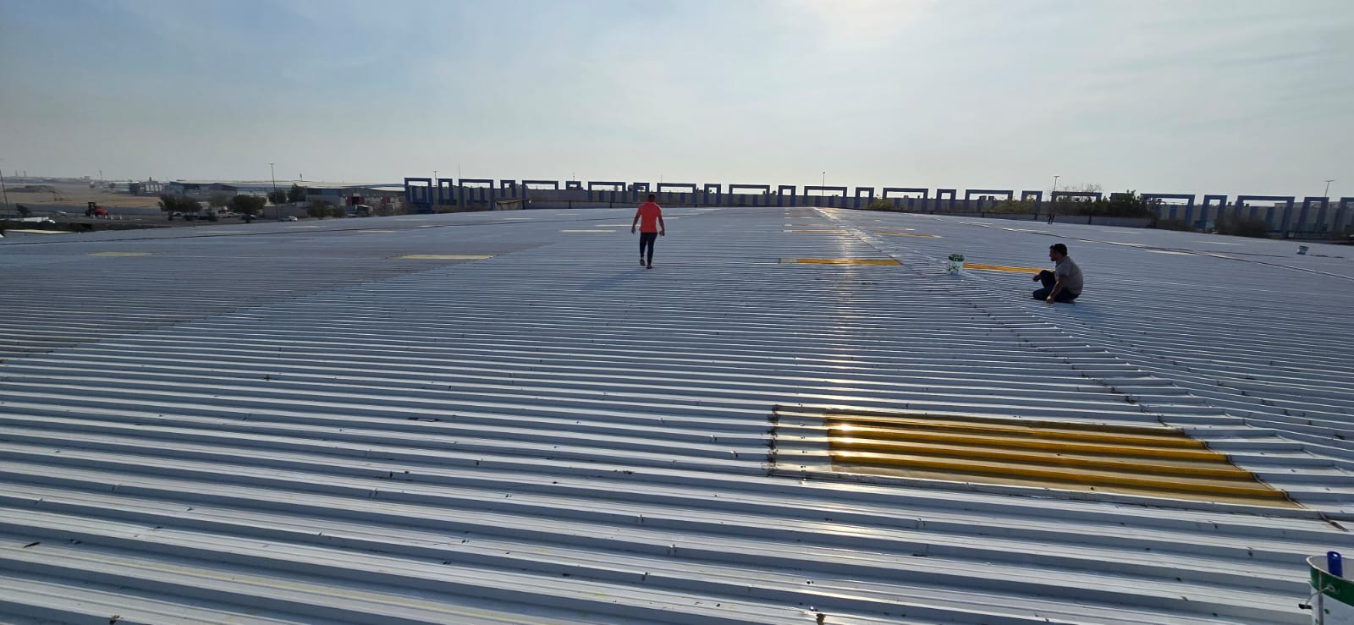
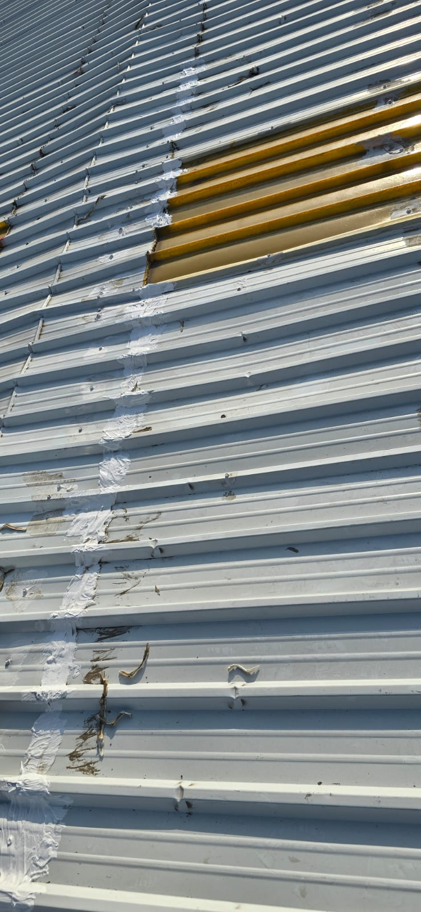
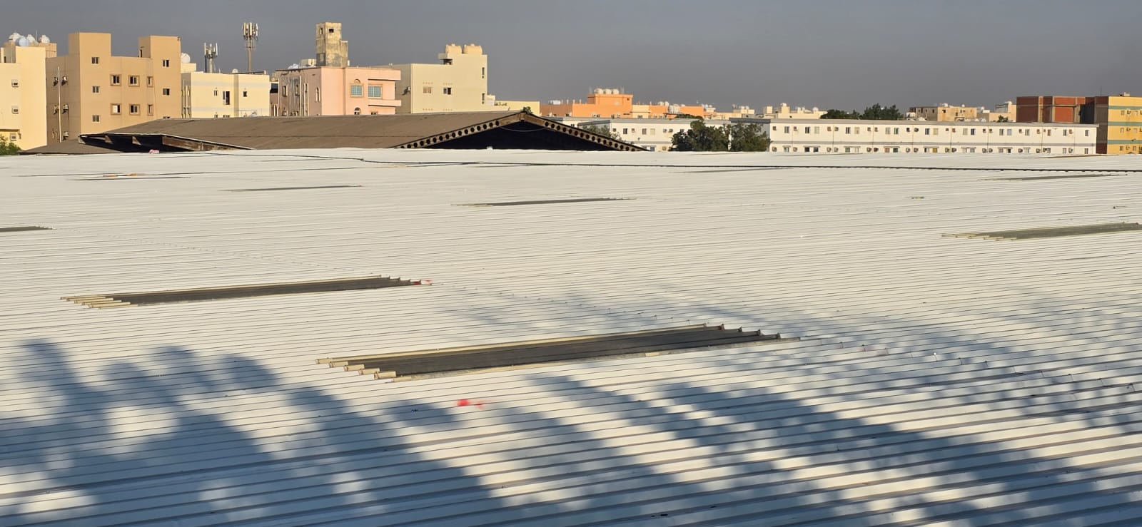
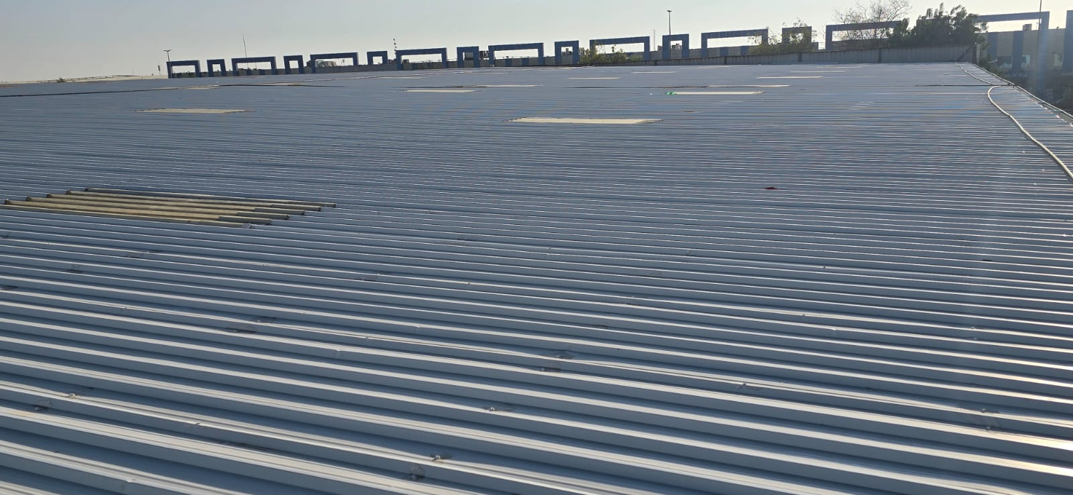
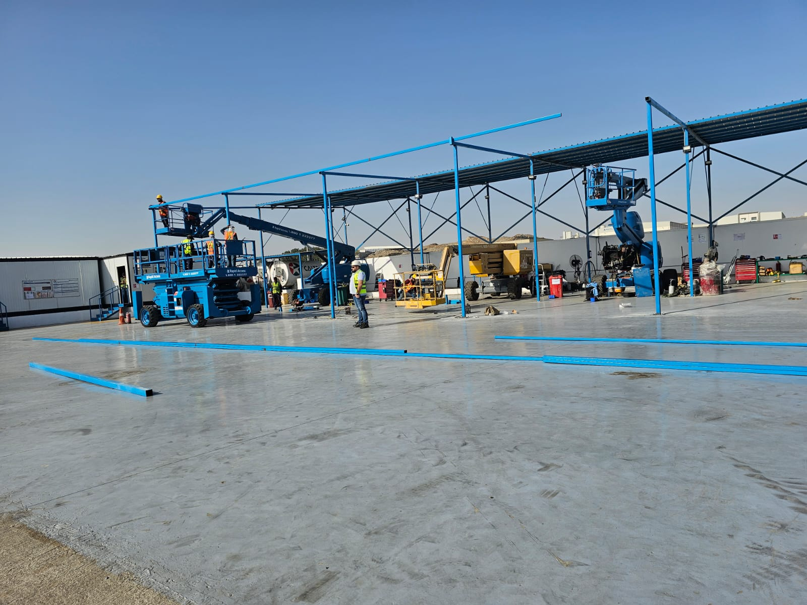
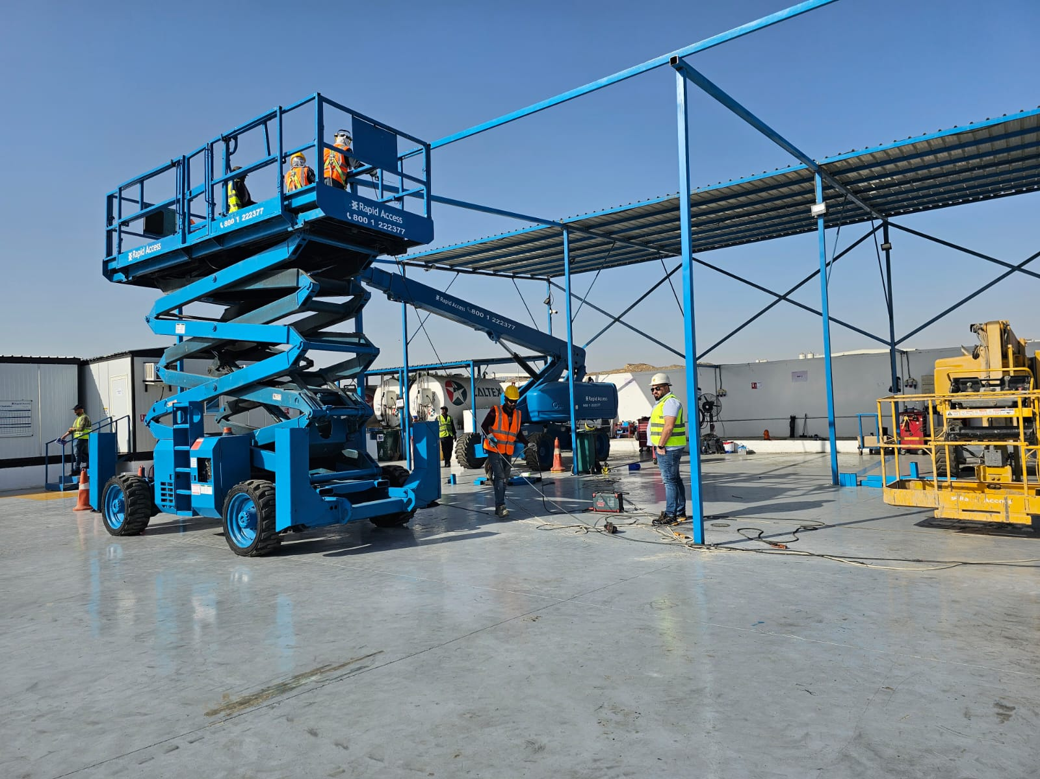
Hangar Installation
Overview
Bayan Alforsan erected multiple wide-span aircraft hangars—excavating foundations, setting heavy-steel portal frames, installing insulated cladding, and connecting all electrical & HVAC services—delivering each bay on schedule and passing inspection first time.
Company Profile 2025

Slide 17
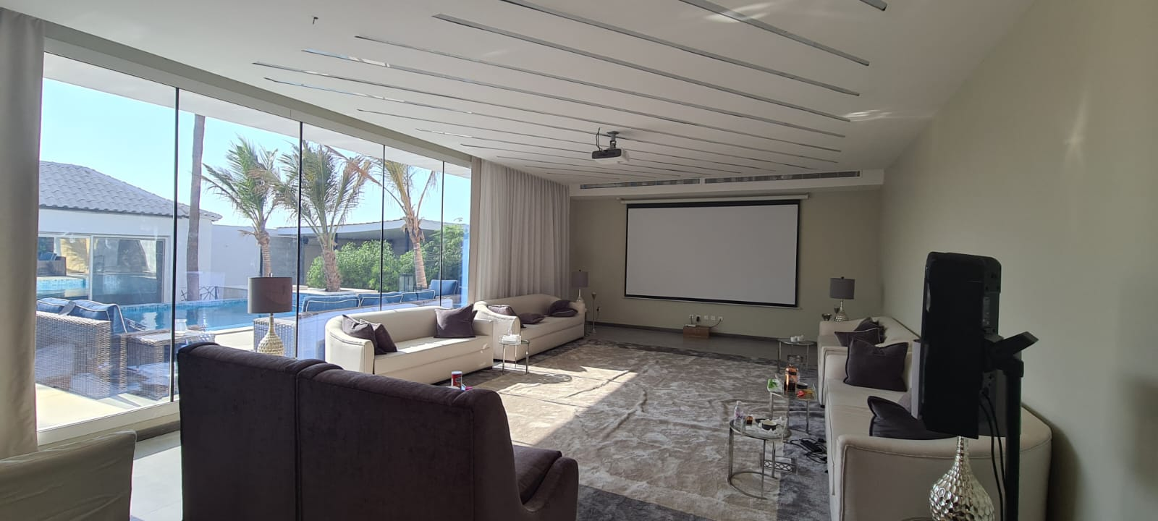
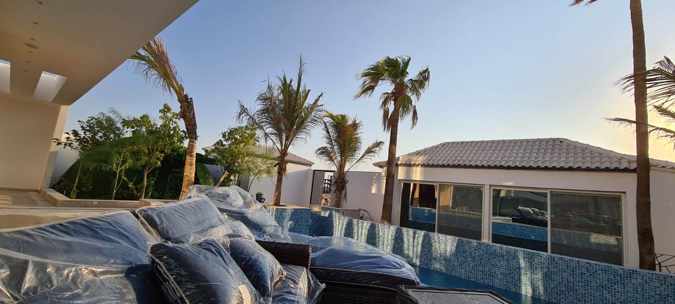




Villa Constructions
Overview
Bayan Alforsan has delivered multiple private villas from virgin ground to turnkey homes: excavation, reinforced-concrete superstructures, full MEP, insulated façades, roofing, and interior finishes—each villa handed over move-in ready under a single, lump-sum contract.
Company Profile 2025

Slide 18



Tent Constructions
Overview
Bayan Alforsan fabricates and erects high-tensile fabric tents—steel mast and cable systems, fire-rated membranes, anchored foundations—creating weather-proof shade or event space, installed and signed-off in days.
Company Profile 2025

Slide 19



Porta Cabin Constructions
Overview
Bayan Alforsan fabricates and erects high-tensile fabric tents—steel mast and cable systems, fire-rated membranes, anchored foundations—creating weather-proof shade or event space, installed and signed-off in days.
Company Profile 2025

Slide 20






Contact Us
Address
Mohamad Al-Tawil Street, Jeddah, Saudi Arabia
Phone
+966 542 020 104
Email
info@alforsanco.com
Website
www.alforsanco.com
Company Profile 2025

Slide 21





Certificates
Company Profile 2025
info@alforsanco.com

Slide 22


Certificates
Company Profile 2025
info@alforsanco.com

Slide 23

Certificates
Company Profile 2025
info@alforsanco.com

Slide 24







Thank You
Alforsan
Architectural Contracting
"From footing to finish – we keep our word."
Quality
Integrity
Safety
Customer Satisfaction
Company Profile 2025
info@alforsanco.com

